Slide 1

STATS 250 Lab 4
Jiangyue Mao

Slide 2
Course Reminders
Assignment | Due Date
Lab 4 | Thursday, March 9th by 11:59pm
Exam 1
Solutions are posted to Canvas
Pop into office hours or reach out to me if you have any questions

Slide 3
Lab 4
Learning Objectives
Population proportions and sample proportions
Review the sampling distribution of the sample proportion
Carry out a hypothesis test for a population proportion
Estimate a population proportion using a confidence interval

Slide 4
Lab 4
Head to https://rstudio.cloud/
If you are not signed in…
Click on “Log In”
Click “Log In with Google”
Log In with your UM credentials
Click the “Start” button next to the “lab04” assignment

Slide 5
stats250package
We have created our own package which contains useful functions that we'll be utilizing over the next few labs.
Be sure to run the code chunk to load in our package.

Slide 6
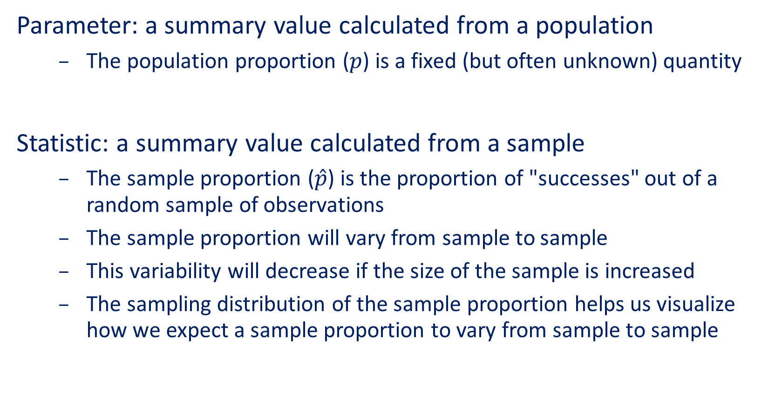
Parameters vs Statistics
Parameter: a summary value calculated from a population
The population proportion ($p$) is a fixed (but often unknown) quantity
Statistic: a summary value calculated from a sample
The sample proportion ($\hat{p}$) is the proportion of "successes" out of a random sample of observations
The sample proportion will vary from sample to sample
This variability will decrease if the size of the sample is increased
The sampling distribution of the sample proportion helps us visualize how we expect a sample proportion to vary from sample to sample

Slide 7
Proportions vs Means
Proportions are used to help summarize a categorical variable, specifically when the response is a yes/no scenario
Means are used to help summarize a quantitative variable by calculating the average value of some numeric response

Slide 8
Hypothesis Tests vs Confidence Intervals
Hypothesis tests help us evaluate a claim or statement made about an unknown parameter of interest
Confidence intervals help us estimate an unknown parameter of interest by providing an interval of plausible values

Slide 9
Employee Data Set
We will revisit the employee data set from Lab 3. This data set contains information for all of the employees in a certain company.
Some of the categorical variables include minority, female, and manager. From these variables, we might be interested in finding...
What proportion of employees are minorities?
What proportion of employees are female?
What percent of employees are managers?

Slide 10
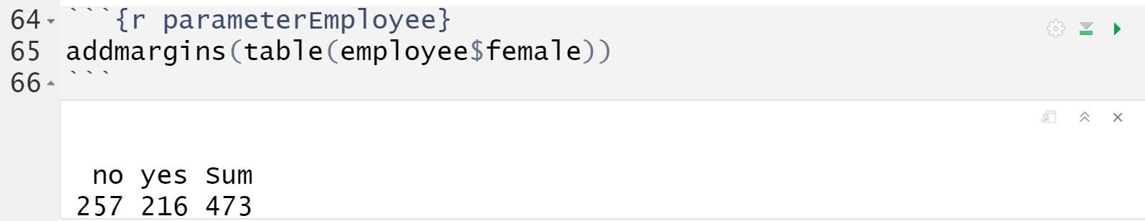
Population Proportion
The table() function helps us calculate these proportions
Because we have data for all 473 employees, the value of 216 / 473 (or 0.4567) would be considered a population proportion.
This value is considered a parameter

Slide 11
Sample Proportions
Suppose we can't collect information on every employee (for one reason or another). And instead, we can only collect a subset - or sample - of employees.
Numerical summaries (such as the sample proportion)calculated from this subset are called statistics.
Statistics will vary from sample to sample!

Slide 12
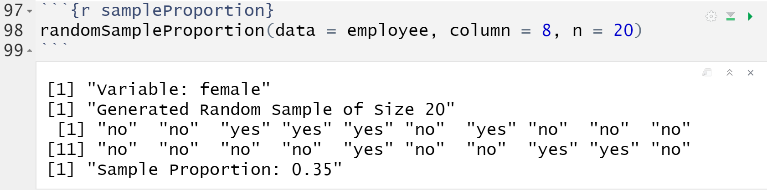
randomSampleProportion()
Takes a random sample and calculates the sample proportion
Arguments:
data: the data set of interest (employee)
column: the column number of the variable of interest (column = 8)
n: the size of the random sample (n = 20)

Slide 13
Demo #1
Use the randomSampleProportion() function to calculate the sample proportion of female employees for a random sample of 120 employees (n = 120).
Think About It: Will the sampling distribution of the sample proportion be wider or narrower with an increased sample size?

Slide 14
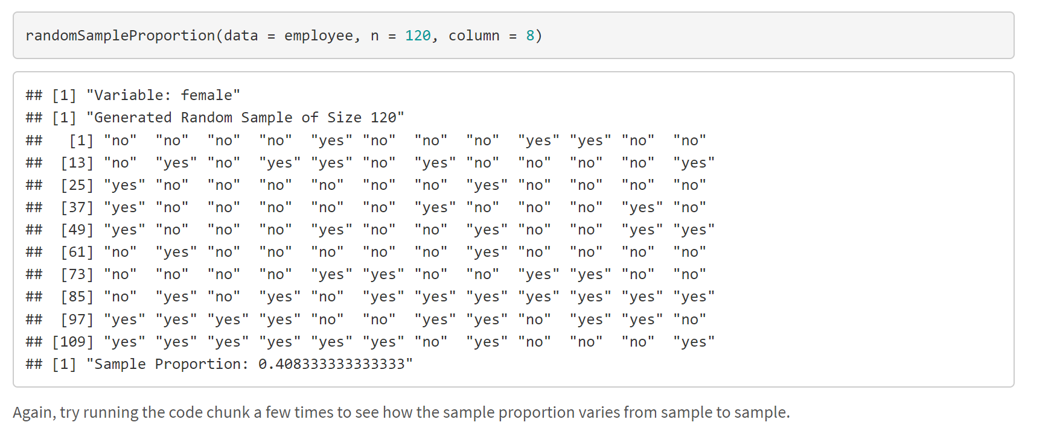
Notes:
Think About It: Will the sampling distribution of the sample proportion be wider or narrower with an increased sample size? The sampling distribution will be narrower with an increased sample size - we expect the sample proportion to vary be less from sample to sample.

Slide 15
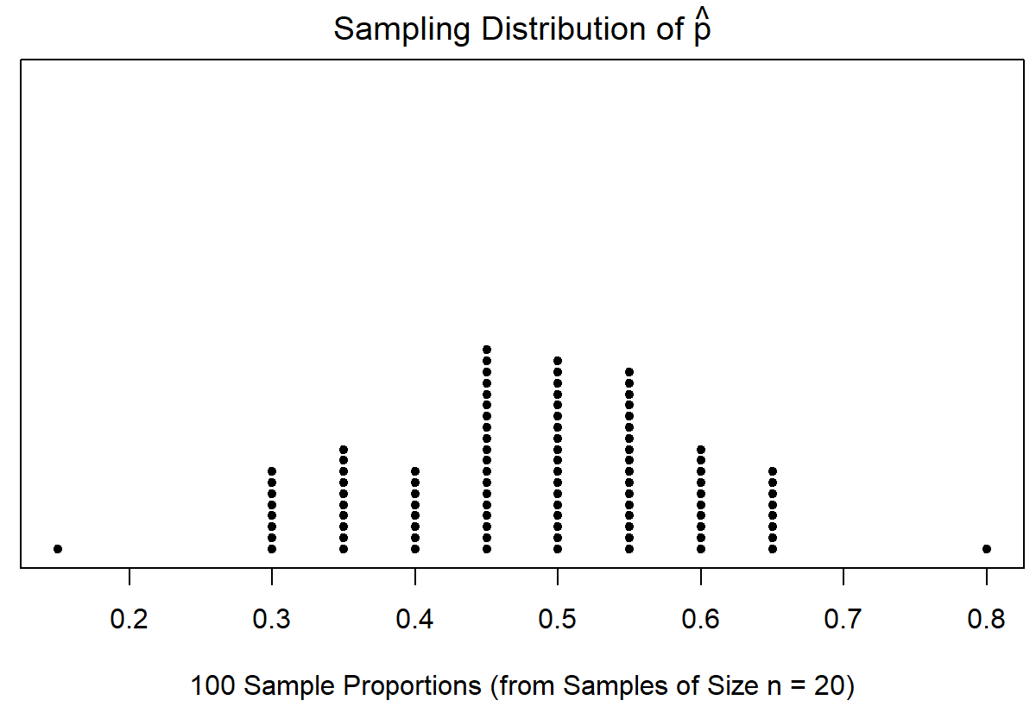
samplingDistProportion()
We can start to visualize the idea of the sampling distribution of the sample proportion by using the samplingDistProportion() function.
This plots 100 different sample proportions from our population
Notes:
Take a random sample of size n from the population
From this random sample, compute the sample proportion
Save the value of the sample proportion computed in Step 2
Repeat Steps 1 - 3 many, many times
Create a histogram of the many, many saved sample proportions
We only simulated 100 sample proportions using the above function. We could add more and more sample proportions to get a better picture of the true sampling distribution of the sample proportion. But this is a good start!
We see that the sampling distribution is centered around 0.45 or so. (Remember, the population proportion was 0.4567). We also see that the sample proportions vary by quite a bit!

Slide 16
Demo #2
Use the samplingDistProportion() function to plot a bunch of sample proportions of female employees (for a random samples of size 120).
Think About It:
True/False: In Demo 2, the sampling distribution of the sample proportion is approximately normal because the sample size is large enough (at least 25) to use the Central Limit Theorem.

Slide 17
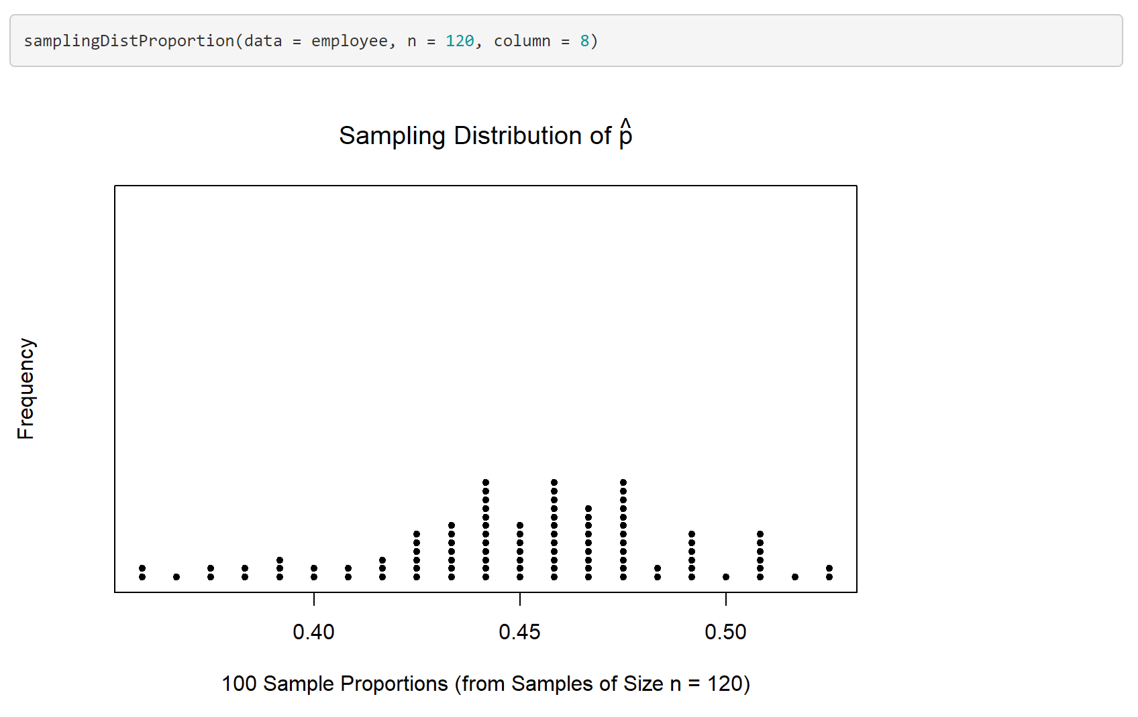
Notes:
We should find that the sampling distribution is still centered around 0.4567 and that the sample proportions vary by less (compared to when the sample size was 20).

Slide 18
Demo #2
Use the samplingDistProportion() function to plot a bunch of sample proportions of female employees (for a random samples of size 120).
Think About It:
True/False: In Demo 2, the sampling distribution of the sample proportion is approximately normal because the sample size is large enough (at least 25) to use the Central Limit Theorem.
False! The Central Limit Theorem is for the sampling distribution of the sample mean (when working with a quantitative response). For categorical data and proportions, we use np and n(1-p) to ensure the sample size is large enough to perform the analysis.

Slide 19


Sampling Distribution of $\hat{p}$
$\hat{p}$ = $\frac{x}{n}$
$$E\left(\hat{p}\right)=p$$
$$s.d.\left(\hat{p}\right)=\sqrt{\frac{p\left(1−p\right)}{n}}$$
If the sample size is large enough,
then the sampling distribution of $\hat{p}$ is approximately normal
$$np≥10; n\left(1−p\right)≥10$$
Notes:
Result #1: The expected value (or center) of the sampling distribution of the sample proportion (E(phat)) is equal to the population proportion (p).
Result #2: The standard deviation (or spread) of the sampling distribution of the sample proportion (sd(phat)) decreases as the sample size increases.
Result #3: The shape of the sampling distribution of the sample proportion can be approximated with a normal distribution when the sample size is large enough.

Slide 20
Hypothesis Tests
A hypothesis test helps us judge whether or not a statement about a population is reasonable or not. The procedure for running any hypothesis test involves three steps:
Determine appropriate null and alternative hypotheses
Check the assumptions for performing the test
Calculate the observed sample proportion and the test statistic. Then, determine the p-value.
First, evaluate the p-value and determine the amount of evidence against the null hypothesis. Then, make a conclusion in the context of the problem.

Slide 21

Hypothesis Tests
For a hypothesis test involving one population proportion, the possible hypotheses are:
$$H_{0}:p=p_{0} vs H_{a}:p>p_{0}$$
$$H_{0}:p=p_{0} vs H_{a}:p<p_{0}$$
$$H_{0}:p=p_{0} vs H_{a}:p≠p_{0}$$

Slide 22
p-value
During a hypothesis test, we assume that the null hypothesis is true for the calculations of our test statistic and corresponding p-value. The resulting p-value helps us determine how much evidence we have against the null hypothesis (and in favor of the alternative hypothesis). The smaller the p-value, the more evidence we have against the null.
If the p-value is: | Strength of Evidence
Above 0.10 | Not enough evidence against H₀ and in support of H_{a}
Between 0.05 and 0.10 | Some evidence against H₀ and in support of H_{a}
Between 0.01 and 0.05 | Strong evidence against H₀ and in support of H_{a}
Less than 0.01 | Very strong evidence against H₀ and in support of H_{a}
Notes:
Note: the p-value is not the probability that the null hypothesis is true. The p-value is the probability of a result as extreme (or more extreme) as the observed test statistic (in the direction of the alternative hypothesis) assuming the null hypothesis is true.

Slide 23
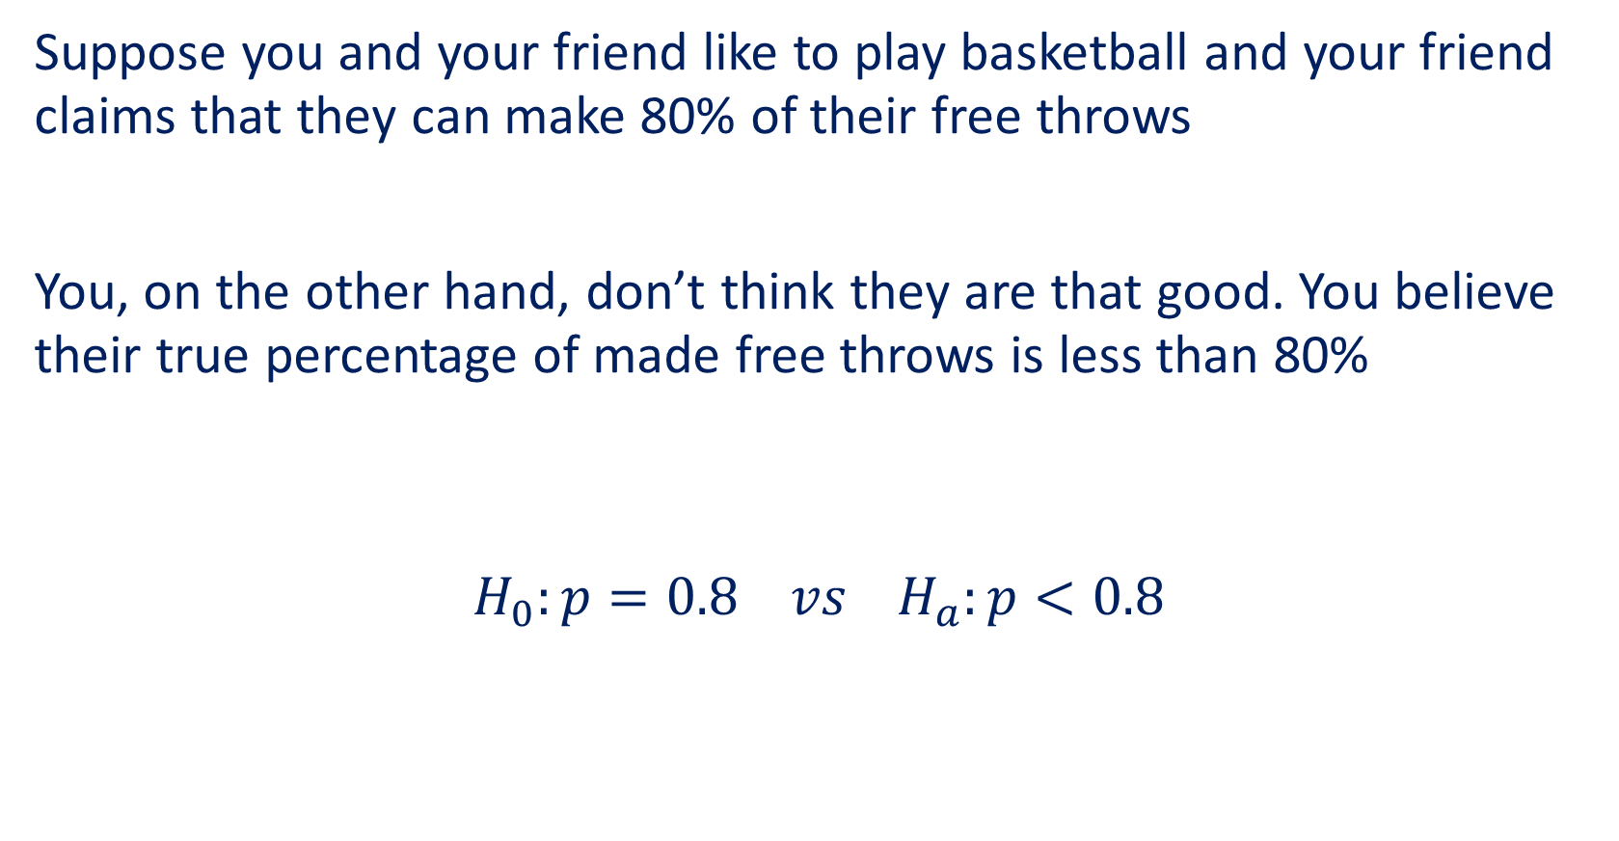
Example
Suppose you and your friend like to play basketball and your friend claims that they can make 80% of their free throws
You, on the other hand, don’t think they are that good. You believe their true percentage of made free throws is less than 80%
$$H_{0}:p=0.8 vs H_{a}:p<0.8$$

Slide 24
Example
To test these theories, you and your friend head to the gym and they shoot 100 free throws. What proportion of free throws would make you doubt their stated value of 80% and support your claim?
Would 78 out of 100 free throws be low enough?
Would 74 out of 100 free throws be low enough?
Would 70 out of 100 free throws be low enough?

Slide 25
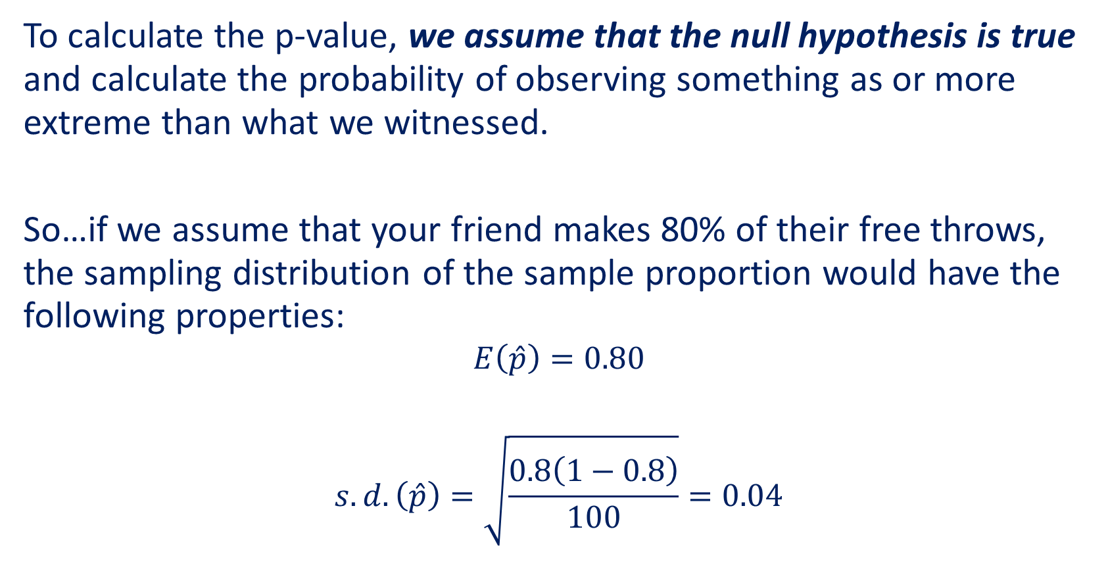
Example
To calculate the p-value, we assume that the null hypothesis is true and calculate the probability of observing something as or more extreme than what we witnessed.
So…if we assume that your friend makes 80% of their free throws, the sampling distribution of the sample proportion would have the following properties:
$$E\left(\hat{p}\right)=0.80$$
$$s.d.\left(\hat{p}\right)=\sqrt{\frac{0.8\left(1−0.8\right)}{100}}=0.04$$

Slide 26
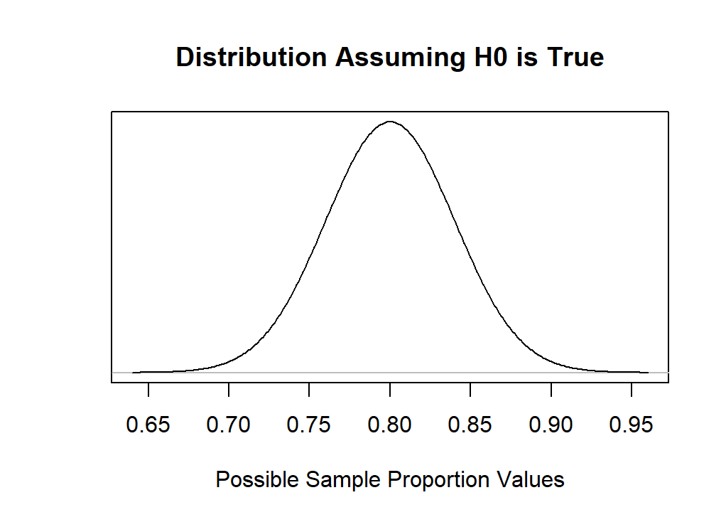
Example
Assuming your friend makes 80% of their free throws, the sampling distribution of the sample proportion would look like this

Slide 27
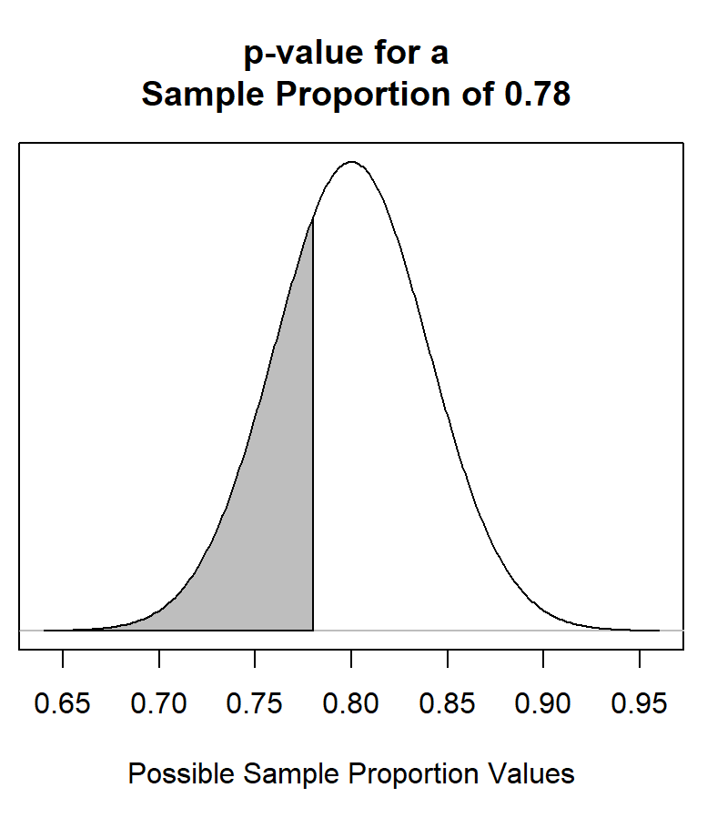
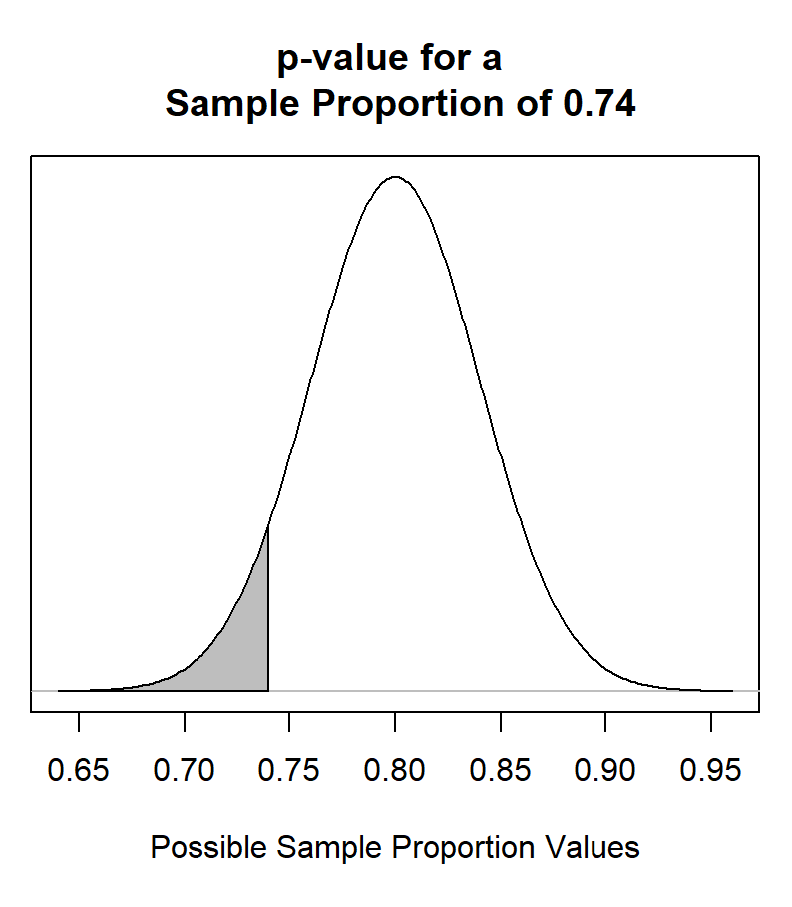
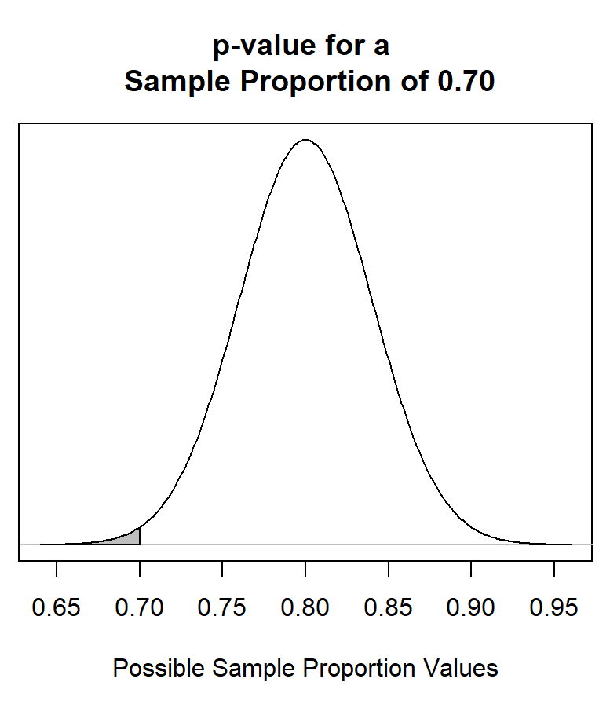
Example
And the p-values for the sample proportions of 0.78, 0.74, and 0.70 would look like this

Slide 28
Example
The more unlikely the outcome, the smaller the p-value
Sample proportion of 0.78 → p-value of 0.3085
Sample proportion of 0.74 → p-value of 0.0668
Sample proportion of 0.70 → p-value of 0.0062
The smaller the p-value, the stronger the evidence against H₀
If the p-value is: | Strength of Evidence
Above 0.10 | Not enough evidence against H₀ and in support of H_{a}
Between 0.05 and 0.10 | Some evidence against H₀ and in support of H_{a}
Between 0.01 and 0.05 | Strong evidence against H₀ and in support of H_{a}
Less than 0.01 | Very strong evidence against H₀ and in support of H_{a}

Slide 29
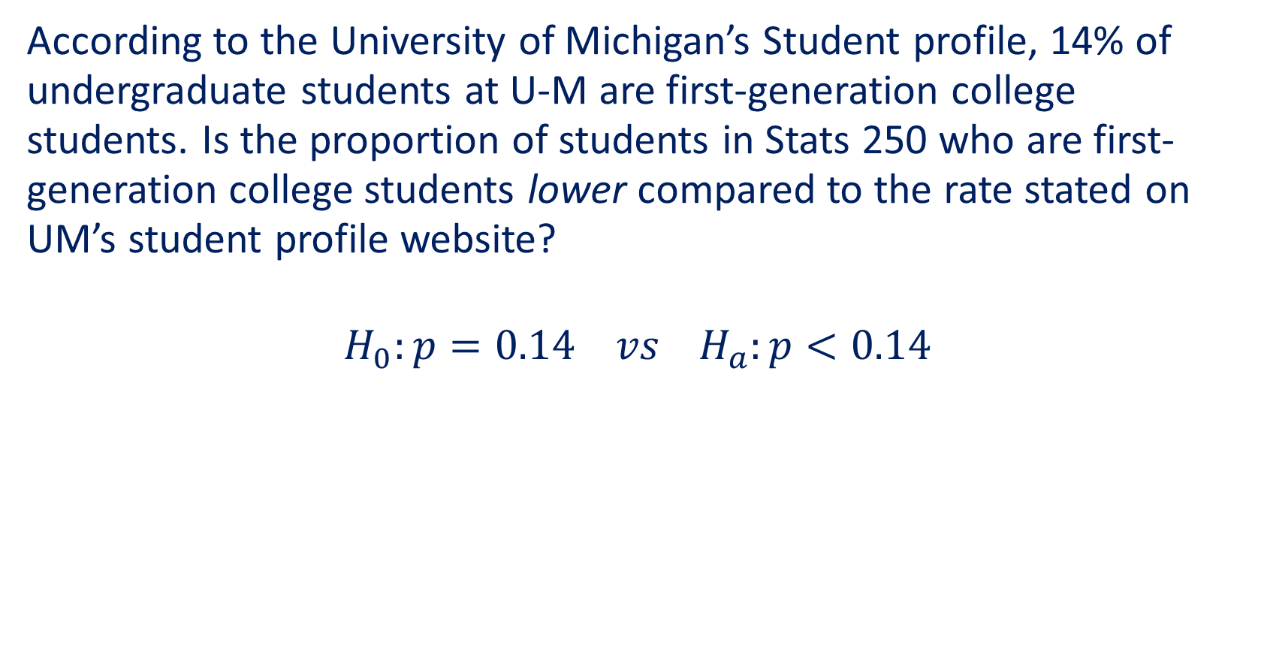
Example (Lecture 11)
According to the University of Michigan’s Student profile, 14% of undergraduate students at U-M are first-generation college students. Is the proportion of students in Stats 250 who are first-generation college students lower compared to the rate stated on UM’s student profile website?
$$H_{0}:p=0.14 vs H_{a}:p<0.14$$

Slide 30
onePopPropHT()
Run a hypothesis test for one population proportion
Arguments:
x: observed number of "successes"
n: sample size
p0: hypothesized proportion
alt: alternative hypothesis ("less", "greater", or "two.sided")

Slide 31
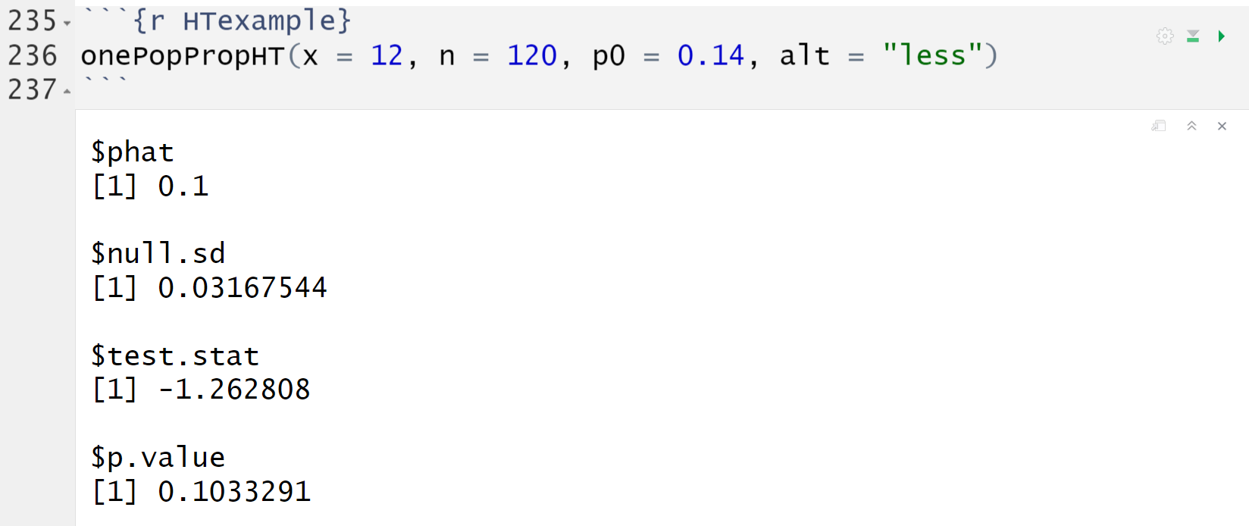
Example (Lecture 11)
The function outputs some useful information:
Notes:
Phat = x/n
Sd = sqrt(p0(1-p0)/n)
Test.stat = (0.1-0.14)/0.0316

Slide 32
Example (Lecture 11)
Evaluation: With a p-value of 0.1033, there is not enough evidence against the null hypothesis and in support of the alternative.
Conclusion: Based on the data, we do not have enough evidence to suggest that less than 14% of all Stats 250 students are first-generation college students.

Slide 33
Demo #3
In a student survey from a prior semester, 30 out of 230 students believe that ketchup could be considered jam (because tomatoes are technically fruit). Use this data (which we will consider a random sample of students) to test if we have enough evidence to conclude that less than a fifth (20%) of all students believe that ketchup can be considered jam.
First, think about how you would write out your null and alternative hypotheses for this test.
Then, use the onePopPropHT() function to calculate the p-value.

Slide 34
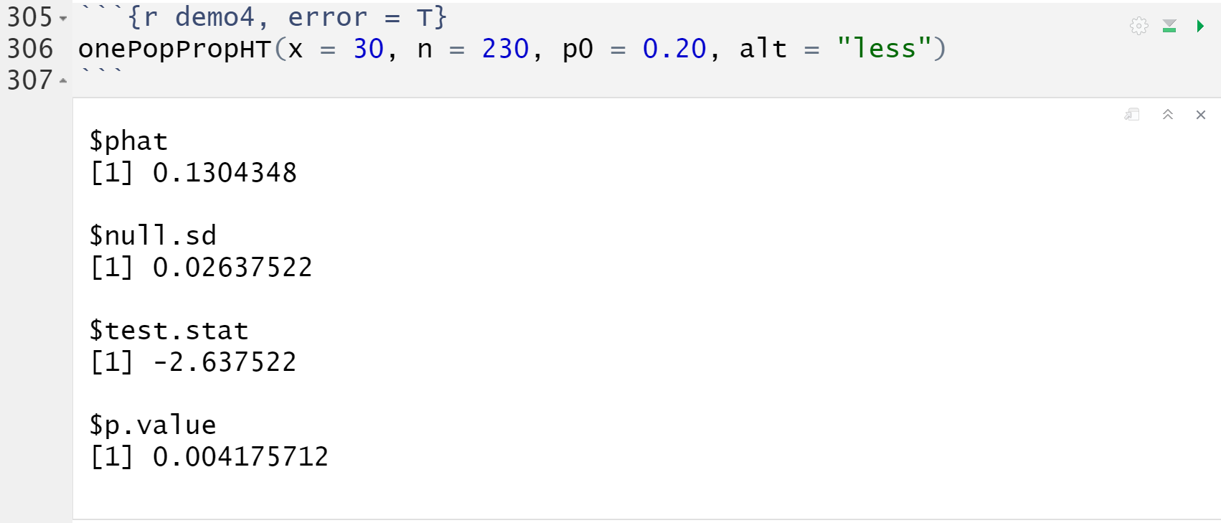
Demo #3
Notes:
H0: a fifth of all students believe that ketchup can be considered jam
Ha: less than a fifth of all students believe that ketchup can be considered jam
With a p-value of 0.0042, there is very strong evidence against the null hypothesis and in support of the alternative. Based on the data, we have very strong evidence to suggest that less than a fifth of all students believe that ketchup can be considered jam.

Slide 35
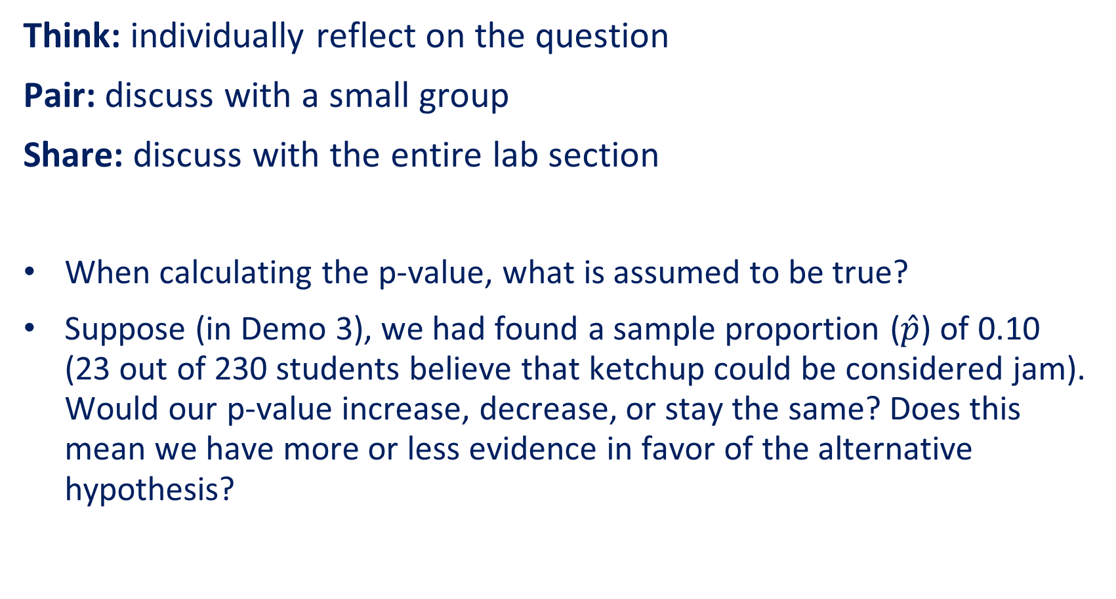
Think-Pair-Share #1
Think: individually reflect on the question
Pair: discuss with a small group
Share: discuss with the entire lab section
When calculating the p-value, what is assumed to be true?
Suppose (in Demo 3), we had found a sample proportion ($\hat{p}$) of 0.10 (23 out of 230 students believe that ketchup could be considered jam). Would our p-value increase, decrease, or stay the same? Does this mean we have more or less evidence in favor of the alternative hypothesis?
Notes:
We assume the null hypothesis is true - that the population proportion is equal to the value stated in the null hypothesis.
If the sample proportion (phat) was even further from the hypothesized value (p0), then we would get a smaller p-value - meaning we have more evidence against the null and in favor of the alternative.

Slide 36
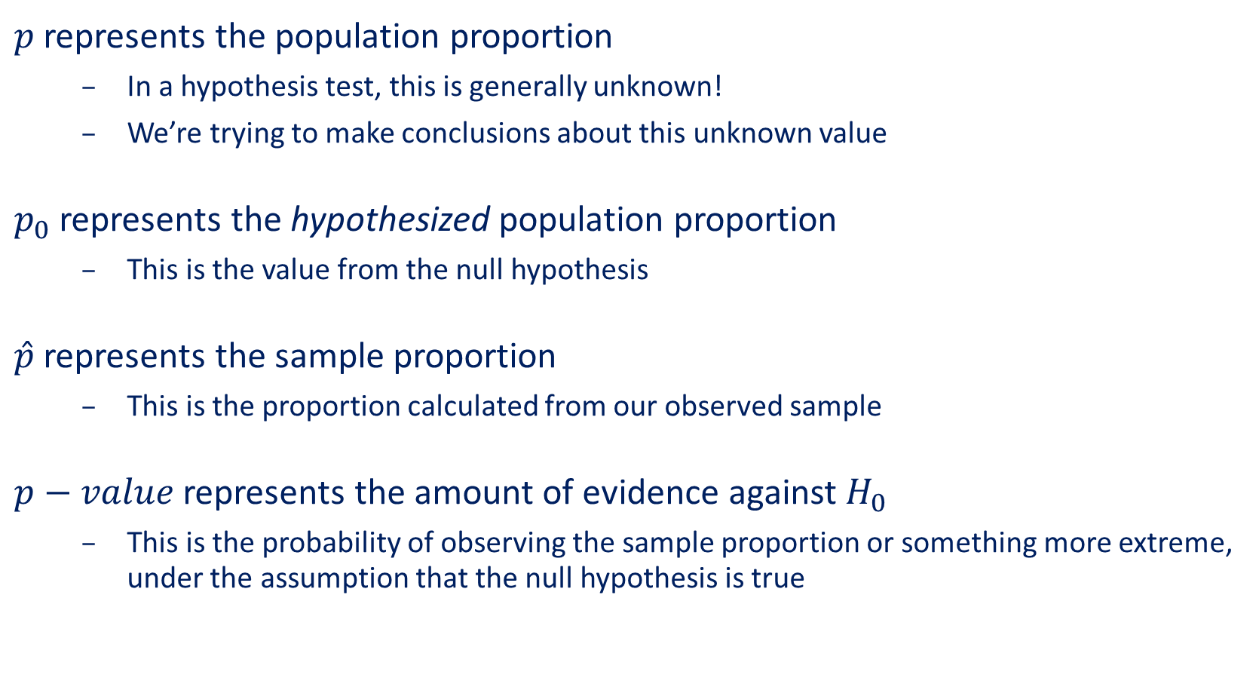
All These P’s
$p$ represents the population proportion
In a hypothesis test, this is generally unknown!
We’re trying to make conclusions about this unknown value
$p_{0}$ represents the hypothesized population proportion
This is the value from the null hypothesis
$\hat{p}$ represents the sample proportion
This is the proportion calculated from our observed sample
$p−value$ represents the amount of evidence against $H_{0}$
This is the probability of observing the sample proportion or something more extreme, under the assumption that the null hypothesis is true

Slide 37
Confidence Intervals
We know that a statistic will vary from sample to sample. So rather than providing only the sample statistic as our estimate of a parameter, we provide a range (or interval) that gives our estimate some “wiggle room”.
Bottom Line: A confidence interval is used to estimate a parameter.
Wiggle Room
Wiggle Room
Sample Estimate

Slide 38




Confidence Intervals
When trying to estimate a population proportion, we calculate the sample proportion, $\hat{p}$, and add some “wiggle room” to the estimate. This wiggle room is called the margin of error ($m$).
$$m$$
$$m$$
$$\hat{p}$$

Slide 39
onePopPropCI()
Creates a confidence interval for a population proportion
Arguments:
x: observed number of "successes"
n: sample size
confidence: confidence level (the default is 0.95)

Slide 40
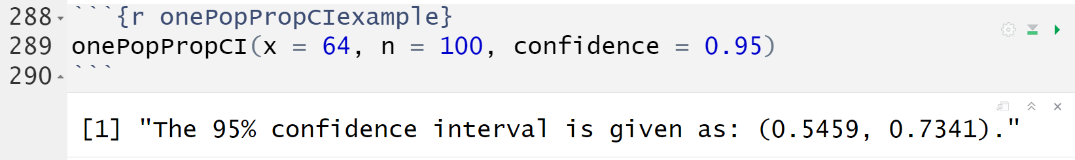

Example (Lecture 12)
Suppose we take a random sample of 100 recent college graduates and record whether the student completed their degree within 4 years. For this sample of 100 recent graduates, 64 reported completing their degree within 4 years.
Using this sample result, compute a 95% confidence interval for estimating the population proportion ($p$) of all recent college graduates who completed their degree within 4 years.

Slide 41
Demo #4
In Demo #3, we ran a hypothesis test to determine if less than a fifth of all students believe that ketchup can be considered jam. Suppose we didn't have any preconceived belief about the population proportion and wished to simply estimate the true value instead.
Use the collected data (30 out of 230 students) and the onePopPropCI() function to create a 90% confidence interval that estimates the population proportion of students who believe that ketchup can be considered jam.
Think about how you would interpret this interval in context.

Slide 42
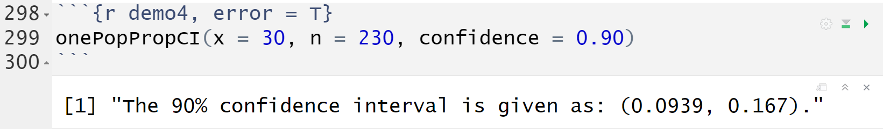
Demo #4
Confidence Interval Interpretation
We estimate, with 90% confidence, that the population proportion of students who believe that ketchup can be considered jam lies between 0.0939 and 0.1670.

Slide 43
Think-Pair-Share #2
Think: individually reflect on the question
Pair: discuss with a small group
Share: discuss with the entire lab section
What component(s) of the confidence interval impact the center of the interval?
What component(s) of the confidence interval impact the width of the interval?
Bonus Question: Our interval in Demo #4 was created using a confidence level of 90%. What exactly does this mean?
Notes:
The point estimate (phat) is the only component that impacts the center.
The confidence level and the sample size both impact the width of the interval. (The standard error (or estimated spread of the sampling distribution) also impacts the width, but we are mainly focusing on the other components here.
The LEVEL is the idea that if we repeated this process many, many times and created many, many intervals of the same confidence level (from various samples of the same size), then we would capture the true population proportion in about 90% of the resulting confidence intervals.

Slide 44
Interpretations
The 90% confidence interval we got was (0.0939 0.1670).
Confidence Interval
We estimate, with 90% confidence, that the population proportion of students who believe that ketchup can be considered jam lies between 0.0939 and 0.1670.
Confidence Level
If we repeated this procedure many times, we would expect 90% of these resulting confidence intervals to contain the population proportion of students who believe that ketchup can be considered jam.

Slide 45
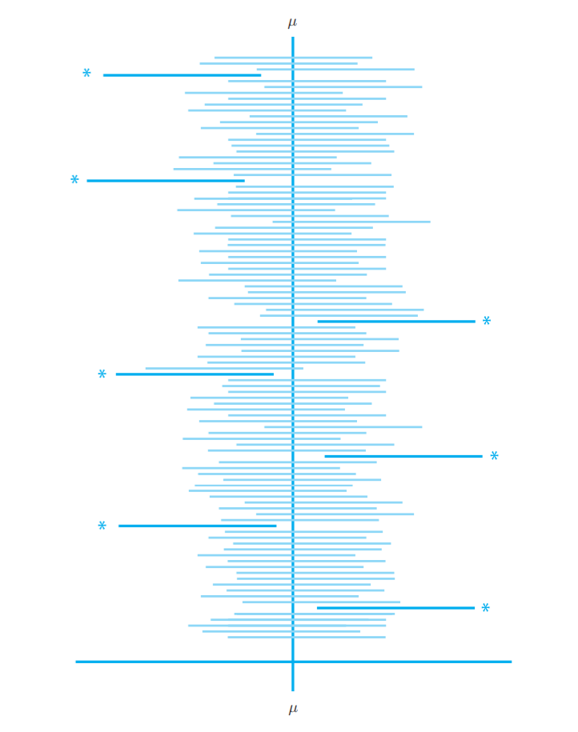
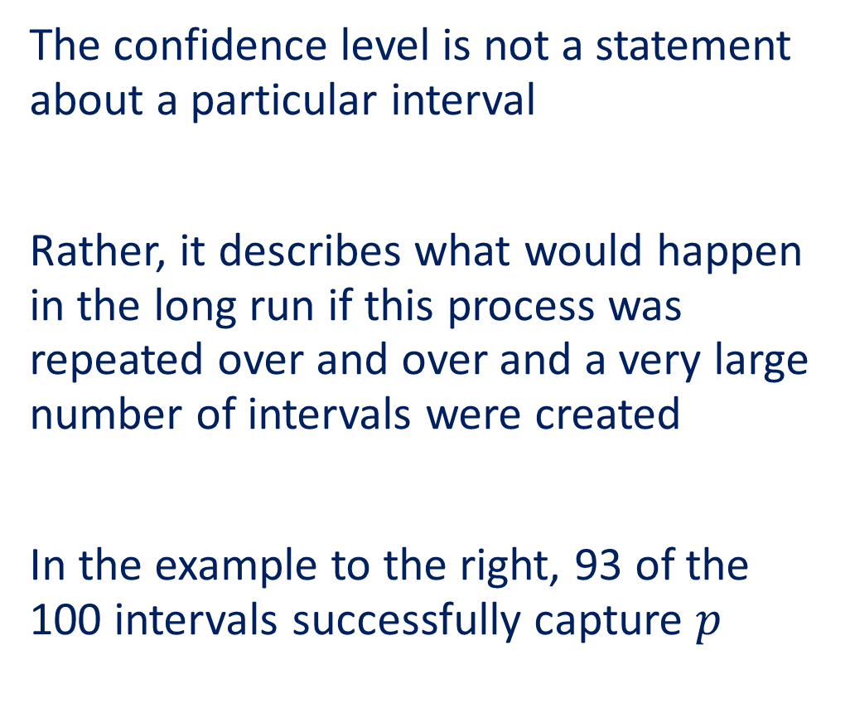


Confidence Level
$$p$$
The confidence level is not a statement about a particular interval
Rather, it describes what would happen in the long run if this process was repeated over and over and a very large number of intervals were created
In the example to the right, 93 of the 100 intervals successfully capture $p$
$$p$$

Slide 46
Interpretations
A confidence interval estimates a population parameter by providing a range of reasonable values for the unknown parameter. This is a single interval calculated using sample data.
A confidence level interpretation explains why the process for constructing a confidence interval is reliable. If we repeat the sampling process many times, a high percentage of the results would contain the unknown value of the parameter.

